Slide 1
Melanie Silverman MS, RD, IBCLC
Registered Dietitian
Lactation Consultant
Optimal Nutrition In
Prader-Willi Syndrome
Vancouver, BC
October 2015

Slide 2

www.melaniesilverman.com

Slide 3
Services I Offer….
Picky Eaters
Poor Weight Gain
Overweight & Obesity
Food Allergies & Intolerances
Tube Feedings
Breastfeeding
Adult Weight Management: Intuitive Eating
Prader-Willi Syndrome

Slide 4
Objectives
WHAT to feed
  Nutrition 101
  Ratio of carbohydrate, protein and fat
  Different types of diets-Which is best?
  Food labels
  Supplements
  Hydration
HOW to feed
  Structure
  Rules
  Advocate

Slide 5

Nutrition 101
Calories
Carbohydrate
Protein
Fat
Vitamins
Minerals
Water

Slide 6
Calories
Calories=A unit of energy
(or the fuel for the body)

Slide 7
Where do CALORIES come from?
Carbohydrate
Protein
Fat

Slide 8
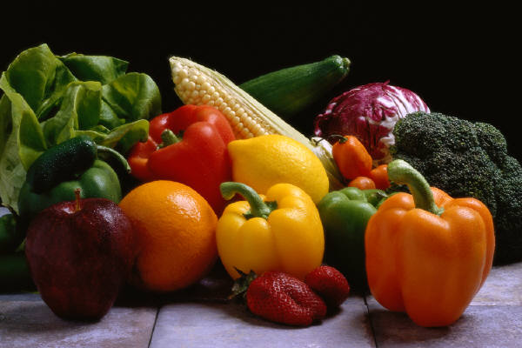
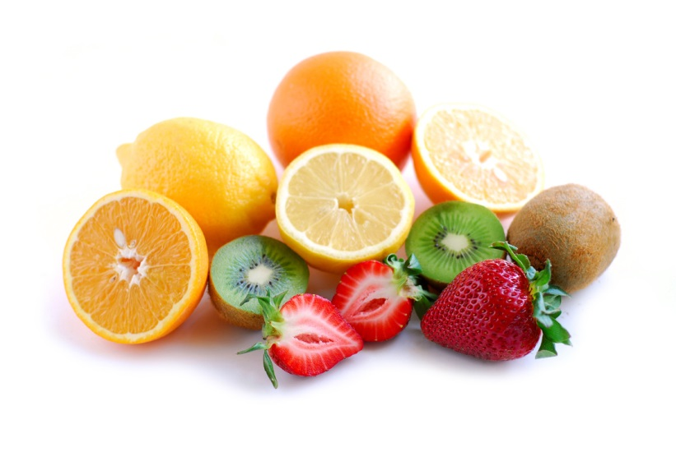
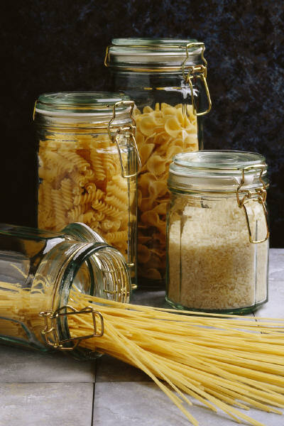
Carbohydrates (CHO)

Slide 9
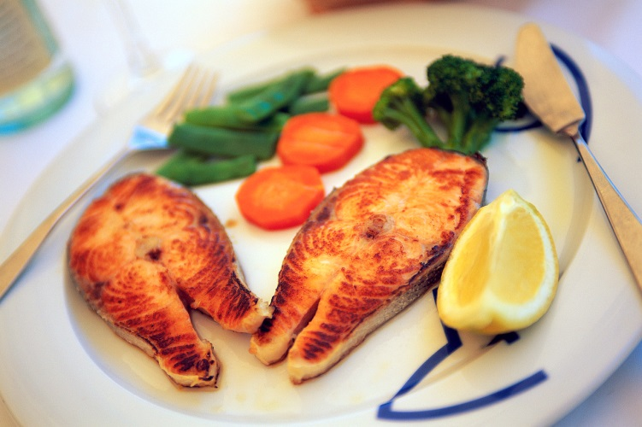
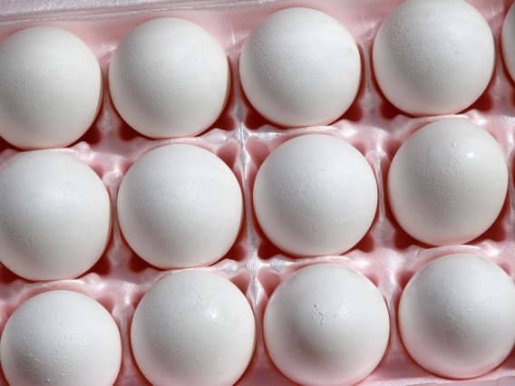
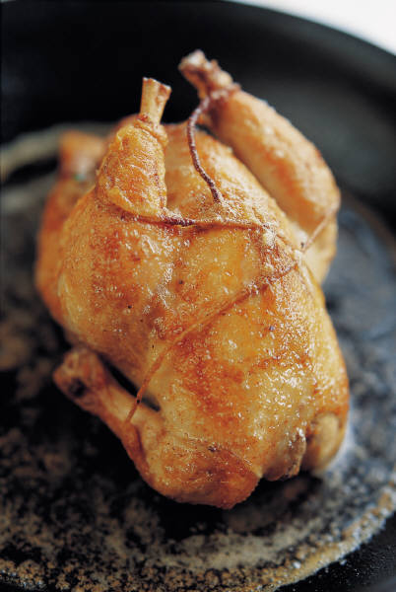
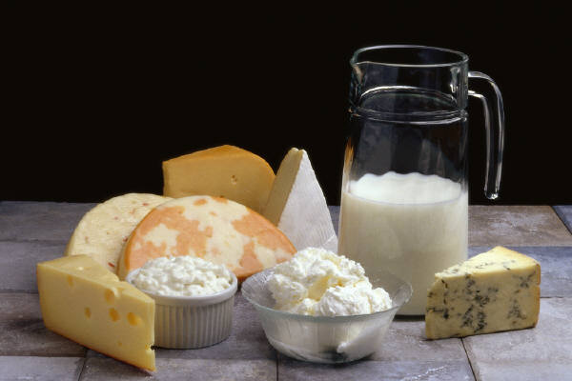
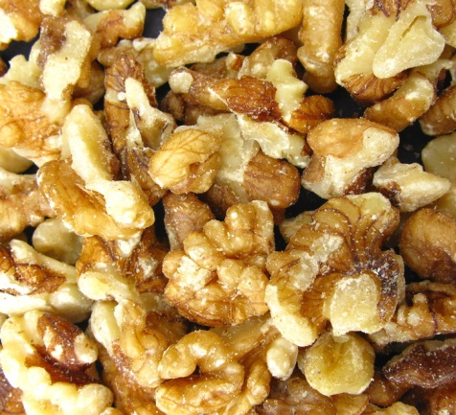
Protein (PRO)

Slide 10
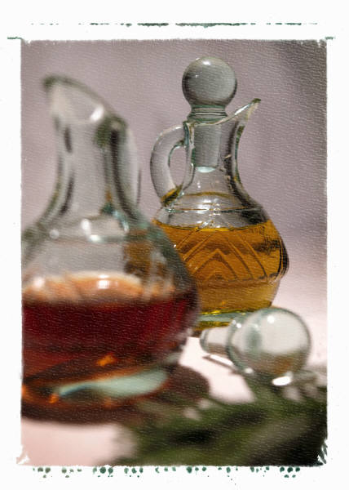
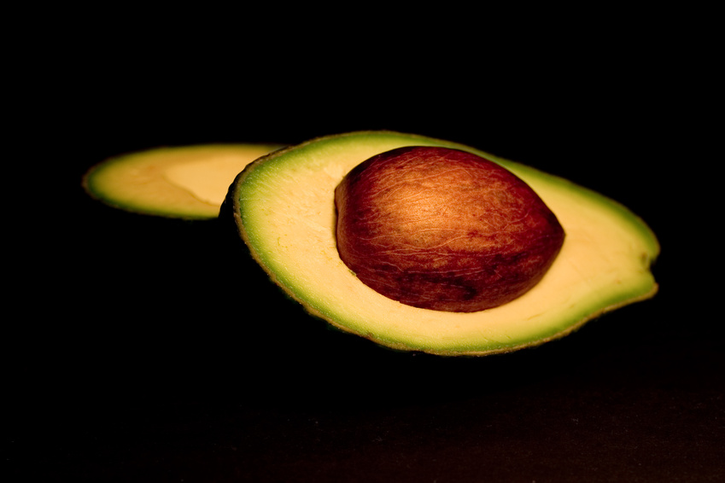
Fat (Fat)

Slide 11
Combination Foods
Eggs: PRO, FAT
Yogurt and Milk: CHO, PRO, FAT
Nuts and seeds: PRO, FAT
Beans, Lentils: CHO, PRO, FAT
Cottage Cheese: PRO, FAT

Slide 12
What Do They Do?
CHO: energy and disease protection
PRO: repair cells and make new ones, important for growth, muscles
FAT: energy, soft skin, fat soluble vitamin metabolism

Slide 13
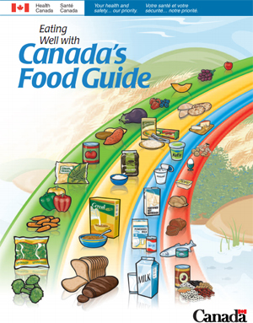

Slide 14
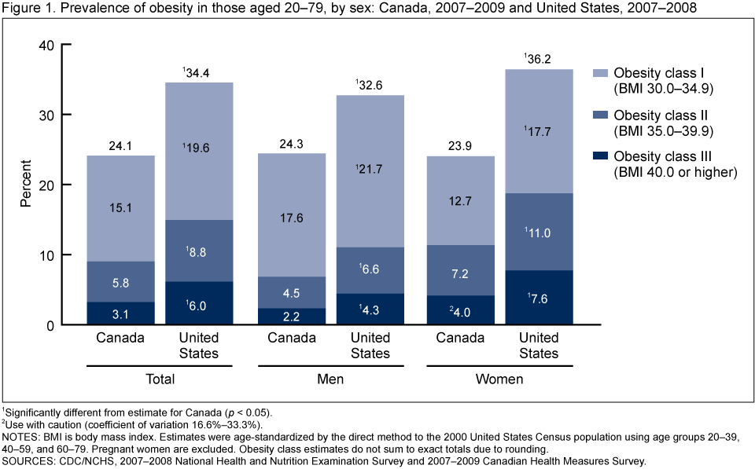

Slide 15
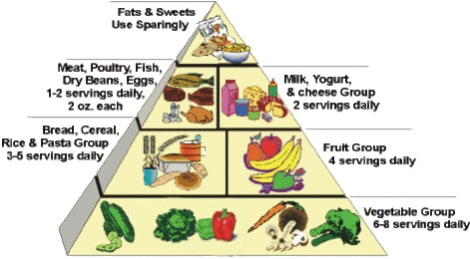
Prader-Willi Food Pyramid

Slide 16

My Plate

Slide 17
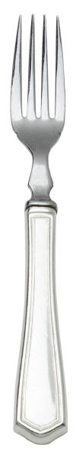
PWS Plate?

Slide 18
GOOD Carbs vs. BAD Carbs
“GOOD”
“BAD”
Vegetables
Fruits
Whole grains (>3 grams fiber per serving)
Beans, Peas, Lentils
Brown rice
Quinoa
Candy
Cakes
Cookies
Juices
Muffins
Ice Cream
Donuts
Low fiber crackers
WHITE bread, pasta, rice

Slide 19
Calorie Percentages
EXAMPLE: 1000 calories per day
Certain PERCENTAGE of those calories are carbohydrate, protein and fat.

Slide 20
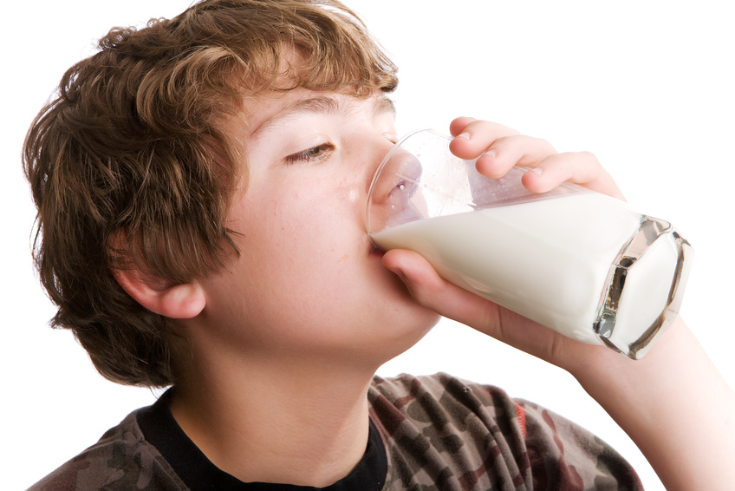
Current Calorie Percentages In America
CARBS: 50-70%
PRO: 15-20%
FAT: 30-35%

Slide 21
PWS Research Study
“A reduced energy intake, well balanced diet improves weight control in children
with Prader-Willi Syndrome”
J.L. Miller, C.H. Lynn, J. Shuster, D.J. Driscoll, 2012
Children ages 2-10
45% carbohydrate, 25% protein, 30% fat
20 grams of fiber
CALORIE CONTROLLED

Slide 22
PWS Research Study
CARBS: 45% (less carbs)
PRO: 25% (more protein)
FAT: 30% (same fat)
FIBER: 20 grams per day
*Miller, et al. A reduced-energy intake, well balanced diet improves weight control in children with Prader-Willi syndrome, J Hum Nutr Diet, 2012

Slide 23
Comparison
USDA
PWS Study
CARBS: 50-70%
PRO: 15-20%
FAT: 30-35%
CARBS: 45%
PRO: 25%
FAT: 30%
FIBER: 20 grams per day

Slide 24
Results
IMPROVES weight and body composition in children with PWS compared to a
simple energy restricted diet
(low fat, high carb)

Slide 25
Low Carb Diets
Low Carb is the trend…but how low do we go?

Slide 26
Low Carb Diets
Low Carb is the trend…but how low do we go?
Not sure

Slide 27
“Diets Discussed on Facebook”
Ketogenic
Modified Adkins Diet (MAD)
Paleo Diet

Slide 28
Ketogenic Diet (KD)
Around since 1920’s for epilepsy (seizures)
Mimics starvation → Usually carbohydrates for used for energy.
KD forces fat use because there is limited CHO
Epilepsy foundation

Slide 29
Ketogenic Diet (KD)
80% FAT diet…the rest carbohydrate and protein. (4 times as much fat as protein and carbohydrates)
Calorie restriction (weight and measure everything to grams)
Epilepsy foundation

Slide 30
Ketogenic Diet (KD)
Seizure Relief Results:
1/3 become seizure free, 1/3 have reduction in seizures and 1/3 don’t succeed because it is too hard
Stay on diet for 2 years and then slowly wean off
Multidisciplinary team monitoring is essential with frequent physician visits, anthropometric measures, blood draws, and urine analysis.
Epilepsy foundation

Slide 31
Risks/Problems with Ketogenic Diet
Dehydration
Constipation
Kidney stones/gall stones
Pancreatitis
Decreased bone density
Vitamin/mineral deficiencies
Slowed growth or weight gain
Source: Epilepsy Foundation

Slide 32
Modified Atkins Diet (MAD)
Modification of traditional ketogenic diet
No need to weigh/measure food
No fluid or calorie restriction

Slide 33
Modified Atkins Diet (MAD)
Fats encouraged and no restriction on protein
Carbs are monitored closely
10-20 grams of CHO per day
One slice of bread is 15 grams of CHO

Slide 34
MAD Diet
Heavy in meats, chicken, fish, turkey, eggs, cheese, oils, avocado, butter, cream
Carbohydrates limited to 1 serving per day
AVOID…Starchy vegetables (corn, dried beans, peas, potatoes), breads, crackers, cakes, cookies, juices, cereals, & rice

Slide 35
MAD Diet
PROBLEMS: lack of variety, very high in fat, no long term research on health risks
This diet is easier than traditional Ketogenic diet for seizure control

Slide 36
Paleo Diet
NO: grains, beans, dairy, vegetable oils, sugar, high fructose corn syrup, artificial sweeteners and highly processed foods
Meat from animals the “way nature intended” (cattle fed on grass)
Fruits & vegetables (but more vegetables)
Avocado and coconut oil
Nuts ,in moderation

Slide 37
Paleo Diet
Advantages: “Real food”
Disadvantages:
  lack of variety
  cost
  adherence
  no documented long term research

Slide 38
Risks Of Low Carb Diets in PWS?
New Thought: Fat is good for the body
Between 0 and 45% CHO per day, we don’t know. (0% is not the answer)
Prolonged ketosis + Growth hormone=???
Complications: clinically, in kids up to 3, we have seen low energy and poor weight gain

Slide 39
What Do I Do?
Be careful and cautious
Ask questions
Work with medical professionals who are knowledgeable and tell them
everything you are doing

Slide 40
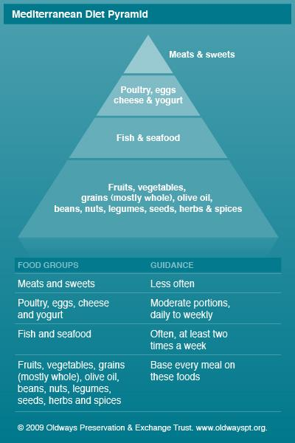
Mayoclinic.org

Slide 41
~45% CHO, 25% PRO, 30% FAT
~1000 calories per day~
BKFST: ½ c. oatmeal, 1 Tbsp. pecans, ½ c. apples, ½ c. enriched almond milk
SNACK: 4 oz. Greek yogurt, ½ c. strawberries
LUNCH: ½ c. beans, 1/3 c. quinoa, 1 plum tomato, ½ c. blackberries
SNACK: ½ c. pears, 2 whole wheat crackers, ¼ oz. peanuts
DINNER: 3 oz. grilled chicken, 4 oz. roasted asparagus, 1/3 c. brown rice, cucumbers, ½ c. watermelon

Slide 42
Following a lower carbohydrate diet?
Calories still count

Slide 43
Meal Makeovers
Before
After
“Flakey Flakes”, Milk, Grapes
Tuna Sandwich, Pretzels, Apple
Spaghetti, Salad and Garlic Bread
Chicken Noodle Soup with Bread sticks, Salad
Oatmeal, Pecans and Raisins
Tuna Salad on Cucumber Slices, Apple
Eggplant Lasagna (roasted eggplant as noodles), berries
Fish, Asparagus, Salad

Slide 44
Meal Makeovers
Before
After
Tacos with Hard Shells
Pasta and Cream Sauce
½ Plain Bagel and Cream Cheese
Buttermilk Pancakes, Eggs, Bacon
Turkey Taco salad (no shell)
Spaghetti SQUASH and tomato sauce
1 Slice Whole Wheat/Sprouted Toast with Peanut Butter
Whole Wheat Waffle, Egg, Bacon

Slide 45
Meal Makeovers
Before
After
Fish, Broccoli, Cornbread, Pears
Cheese Sandwich and Chips
Pita Bread with Egg Salad, Whole Wheat Pretzels and Fruit
Soup in a bread bowl
Fish, Broccoli and Brown rice
Cheese, Fruit, Veggie, Olive Plate
Egg Salad in Lettuce and Fruit
Soup and Salad

Slide 46
Calorie Calculations
Children and adolescents vary:
  10-11 calories per centimeter to maintain growth velocity
  8-9 calories per centimeter for slow weight loss or support linear growth
Adults vary:
  1,000-1,200 per calories day (more or less)
  About 60% of a typical person’s diet
ADA Pediatric Nutrition Assessment, 2008

Slide 47
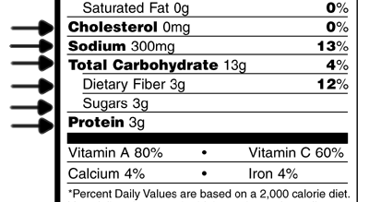
Look at Fiber First….

Slide 48
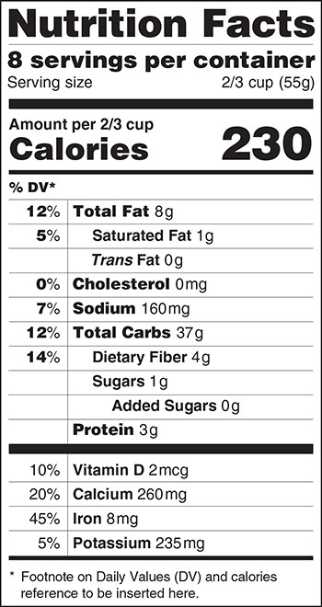
FDA-Consumer Updates

Slide 49

Hydration
Lemons/limes/oranges
Cucumber & mint (grow your own herbs)
Cinnamon sticks/apples
$$$ Flavored waters (Hint, Hint Fizz, Metromint)-read labels

Slide 50
Artificial Sweeteners
Sucralose, Acesulfame K, Saccharin, Neotame, Nutrasweet
Should I use them?
Are they safe?

Slide 51
Artificial Sweeteners
ANSWER 1: I would prefer if you didn’t
ANSWER 2: I am not sure
*Stevia may be OK…use sparingly.

Slide 52
Supplements
Fish Oil = brain and eye development (after 1 year)
Carnitine = alertness, hypotonia
Coenzyme Q10 = energy

Slide 53
More Supplements
Multivitamins: some may need if diet restricted
Iron: Using it without iron deficiency can be dangerous
Vitamin D: Check levels
Vitamin B 12: May improve energy
Probiotics: GI issues (exciting field of research)

Slide 54
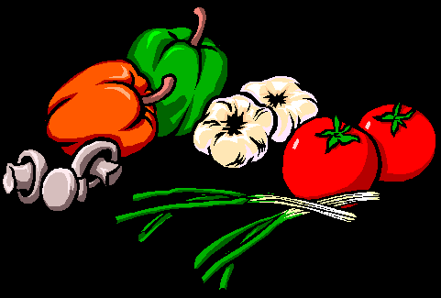
Best Food Sources of Supplements
Carnitine: beef, milk
CoQ10: salmon, tuna, liver, whole grains
Omega 3’s: fish, walnuts, spinach
Vitamin D: salmon, egg yolk, fortified milk and cereal
Probiotics: yogurt, kefir

Slide 55
Supplements in PWS
DISCUSS WITH PHYSICIAN

Slide 56

How To Feed

Slide 57

Structure
Essential

Slide 58
Structure: MENUS
B, S, L, S, D
Separate by at least 2 ½ hours
Post menus

Slide 59
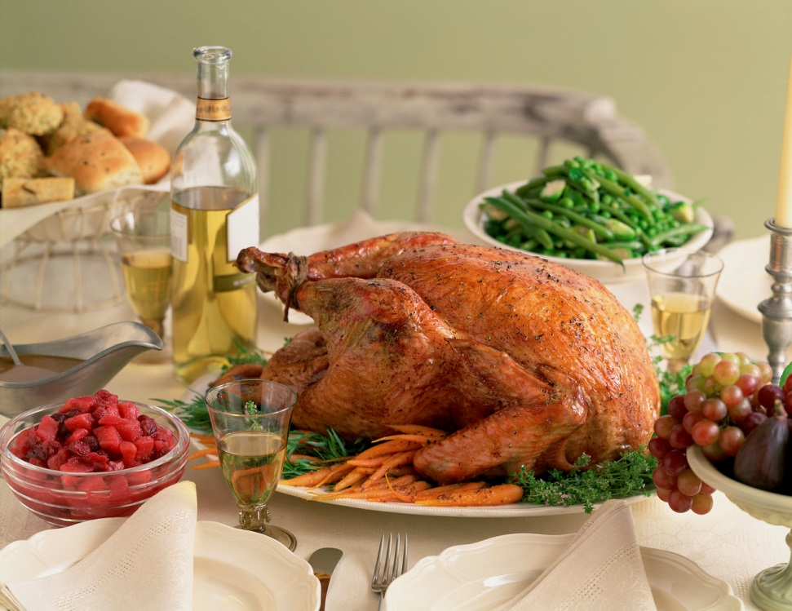
Menu Planning
Eatingwell.com
Emeals.com

Slide 60

Structure: RULES
Post rules
Family meals
No distractions
Eat at the table
Manners

Slide 61

“This Is Just What We Do”
Routines
Rules
Boundaries
Consistency
Balance
PROVIDES: Safety and Security

Slide 62
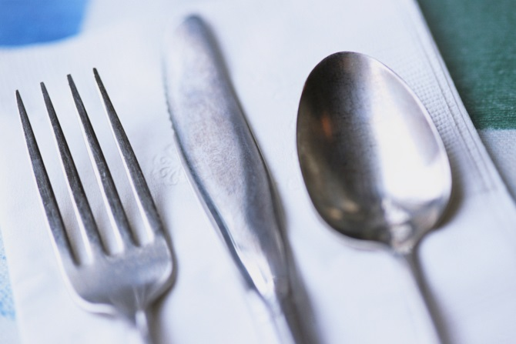
The Kitchen Table
The most important piece of furniture you own
Strengthens:
  Family→sense of support
  Vocabulary
  Manners
  Helps with some picky eaters

Slide 63
Helpful Hints in Feeding with PWS
Plate the food. No family style at the table.
Use smaller plates
Never use food as incentive or reward
Limit buffets or open access to food
Consider using portioned containers

Slide 64
Principles of Food Security in PWS
No doubt when meals will occur and what foods will be served— MENU/RULES
No hope of getting anything different from what is planned—MENU/RULES
No disappointment related to false expectations--MENU/RULES
Linda Gourash, MD & Janice Forster, MD

Slide 65
Ways to Achieve Food Security
Secure food accessibility by locking refrigerator/cabinets
Avoid spontaneity related to food
Supervise food exposure
Post the meal schedule/menus
Try to avoid places and social situations with excess food
Janice L. Foster, MD and Linda M. Gourash, MD Pittsburgh Partnership

Slide 66


Physical Activity
Parks
Hikes (localhikes.com)
Gymnastics
Tae Kwon Do
Rigorous Sports
Family Participation

Slide 67
Physical Activity
ESSENTIAL
For all of us…

Slide 68
Be The Advocate:
Schools/Camps/Residences
Educate teachers, counselors, staff, physicians, aids, pediatricians and other medical professionals
Provide literature
Picture of son/daughter with diagnosis, what it means, emergency contact numbers (food allergic patients do same)

Slide 69
Soccer Snack Letter
Dear Editor:
Youth soccer season is in full force. Along with shin guards and shiny uniforms our kids are getting snacks and plenty of them. If the snacks were fresh fruit and water, I wouldn't be complaining. Parents are complaining to me all over the country about other parents who are bringing cupcakes, candy, donuts, brownies, chips and sugar laden juices. Pumping our kids full of sugar after soccer is a physiologic mistake and sends the wrong message to our kids about taking care of their bodies post exercise. If snacks are to continue, all leagues should set a "fresh fruit and bring your own water policy" to stop our kids from refueling with loads of sugar. Would you eat a cupcake after your 5 mile run? I doubt it. Then why are we feeding our kids this way?

Slide 70
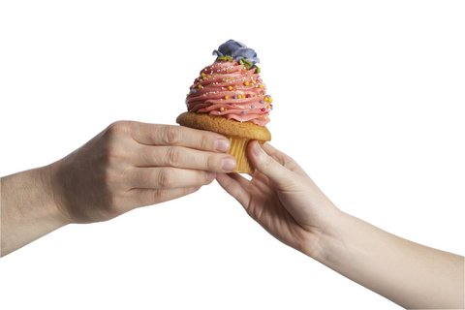
The Huffington Post:
Dear School Principals
…I am asking you to make two simple changes. First, set a non-caloric birthday celebration policy. Stickers, books and creative art projects can be just as celebratory as cupcakes, cookies and candy. In honor of student birthdays, ask them to donate their favorite book to the school library or gather input from all students in the classroom on a charitable donation in honor of birthdays. Second, you must ban food incentives for correct answers. Correct answers should add to a child's self-esteem, not their waistline.

Slide 71
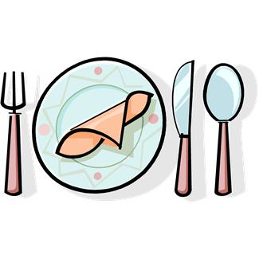
Advice
Structure meals/snack times
Plan meals
Balance of CHO, PRO, FAT
Cook meals with fresh foods
Visit Farmer’s Markets
Shop the perimeter of the grocery store
Read food labels closely
Limit sugar intake
No juice, soda, sport drinks, etc.
Supplements→ask physicians
Intensive, frequent physical activity
Be an advocate

Slide 72


Follow Me…
FeedPhilosophy
Feeding Philosophies

Slide 73
Thank you!
EMAIL: melanie@melaniesilverman.com
OFFICE: 949.607.8248
Melanie R. Silverman MS, RD, IBCLC

